Slide 1

Simulation: Continuous Time Dynamical System
MTH 564 – Mathematical Modeling

Slide 2
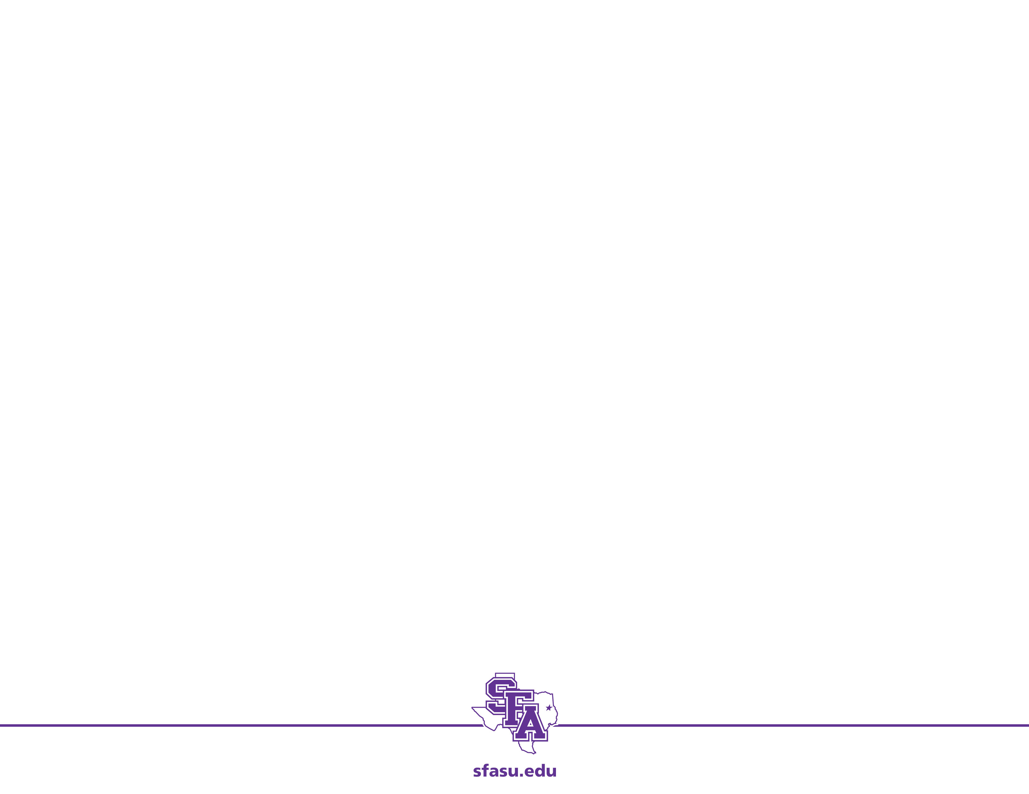

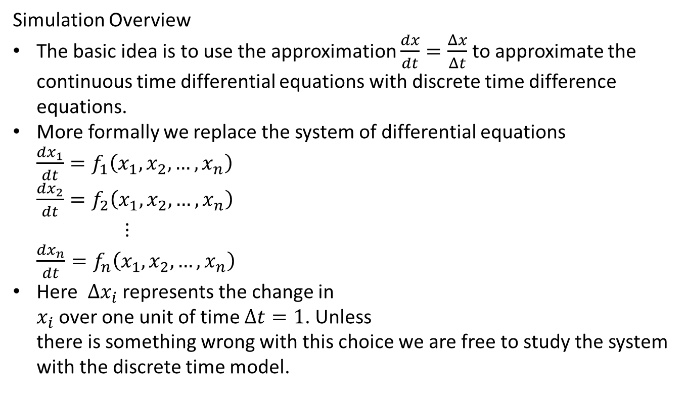
Simulation: Continuous Time Dynamical System
Simulation Overview
The basic idea is to use the approximation $\frac{dx}{dt}=\frac{Δx}{Δt}$ to approximate the continuous time differential equations with discrete time difference equations.
More formally we replace the system of differential equations $\frac{dx_{1}}{dt}=f_{1}\left(x_{1},x_{2}, …, x_{n}\right)$ $\frac{dx_{2}}{dt}=f_{2}\left(x_{1},x_{2}, …, x_{n}\right)$ $⋮$ $\frac{dx_{n}}{dt}=f_{n}\left(x_{1},x_{2}, …, x_{n}\right)$
Here $Δx_{i}$ represents the change in $x_{i}$ over one unit of time $Δt=1$. Unless there is something wrong with this choice we are free to study the system with the discrete time model.
by $Δx_{1}=f_{1}\left(x_{1},x_{2}, …, x_{n}\right)$ $Δx_{2}=f_{2}\left(x_{1},x_{2}, …, x_{n}\right)$ $⋮$
$Δx_{n}=f_{n}\left(x_{1},x_{2}, …, x_{n}\right)$

Slide 3
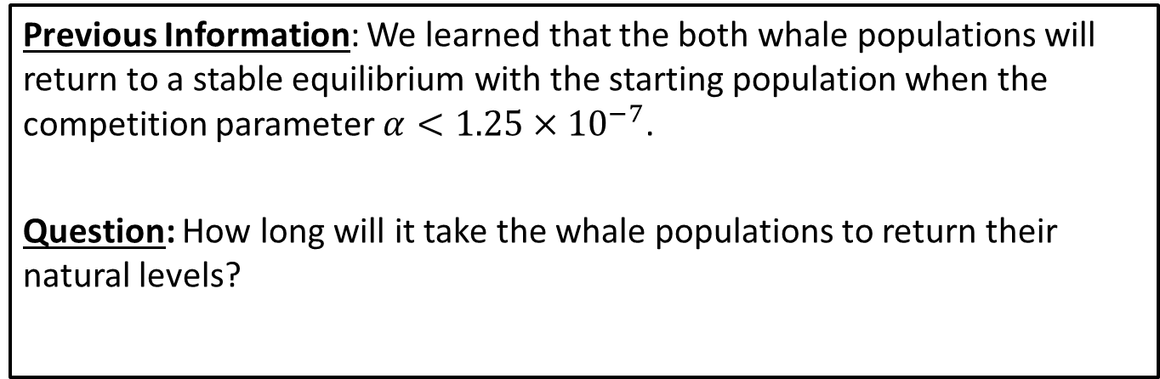
Recall: Whale Population Problem
The blue whale and the fin whale are wo similar species that inhabit the same areas. The intrinsic growth rate is estimated at 5% per year for the blue whale and 8% per year for the fin whale. The environment carrying capacity is estimated at 150,000 for the blue whale and 400,000 for the fin whale. The extent to which the whales compete is unknown. In the last 100 years intense harvesting has reduced the whale population to around 5,000 blue whales and 70,000 fin whales.
Previous Information: We learned that the both whale populations will return to a stable equilibrium with the starting population when the competition parameter $α<1.25×{10}^{−7}$.
Question: How long will it take the whale populations to return their natural levels?

Slide 4
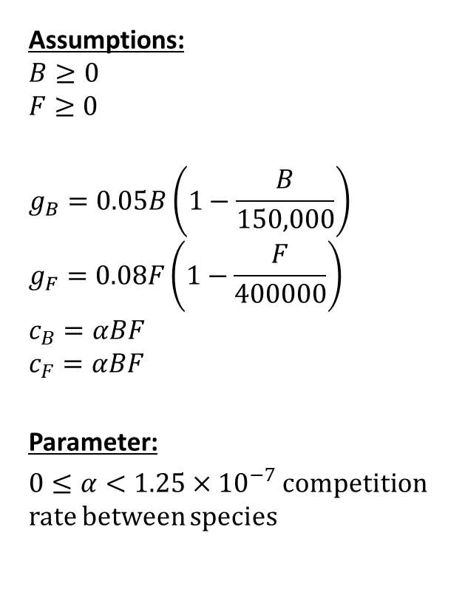
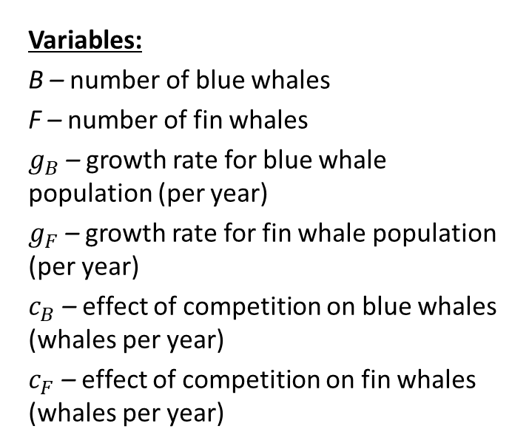
Step 1: Ask the question.
Variables:
B – number of blue whales
F – number of fin whales
$g_{B}$ – growth rate for blue whale population (per year)
$g_{F}$ – growth rate for fin whale population (per year)
$c_{B}$ – effect of competition on blue whales (whales per year)
$c_{F}$ – effect of competition on fin whales (whales per year)
Assumptions:
$$B≥0$$
$$F≥0$$
$$g_{B}=0.05B\left(1−\frac{B}{150,000}\right)$$
$$g_{F}=0.08F\left(1−\frac{F}{400000}\right)$$
$$c_{B}=αBF$$
$$c_{F}=αBF$$
Parameter:
$0≤α<1.25×{10}^{−7}$ competition rate between species
Objective
Determine how long it will take the population to reach stable equilibrium starting from B = 5,000 and F = 70,000.

Slide 5
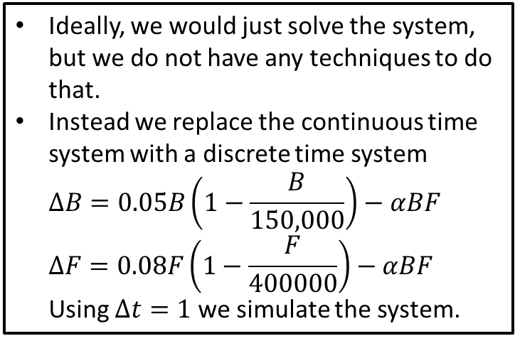
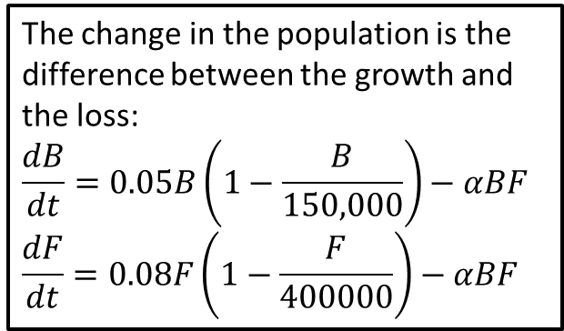
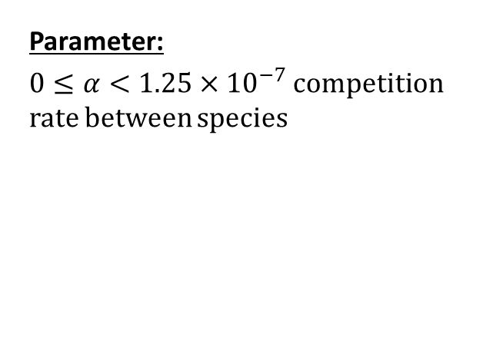
Step 2: Select the modeling approach
The change in the population is the difference between the growth and the loss:
$$\frac{dB}{dt}=0.05B\left(1−\frac{B}{150,000}\right)−αBF$$
$$\frac{dF}{dt}=0.08F\left(1−\frac{F}{400000}\right)−αBF$$
Ideally, we would just solve the system, but we do not have any techniques to do that.
Instead we replace the continuous time system with a discrete time system $ΔB=0.05B\left(1−\frac{B}{150,000}\right)−αBF$ $ΔF=0.08F\left(1−\frac{F}{400000}\right)−αBF$ Using $Δt=1$ we simulate the system.
Parameter:
$0≤α<1.25×{10}^{−7}$ competition rate between species
Objective
Determine how long it will take the population to reach stable equilibrium starting from B = 5,000 and F = 70,000.

Slide 6
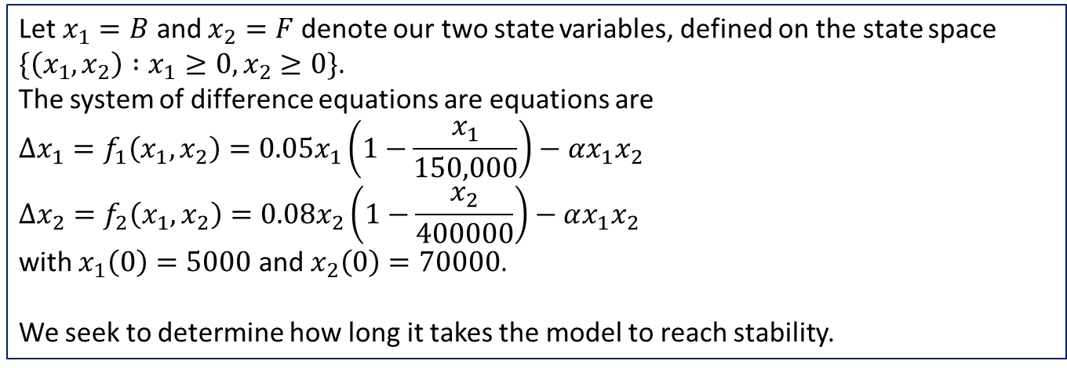
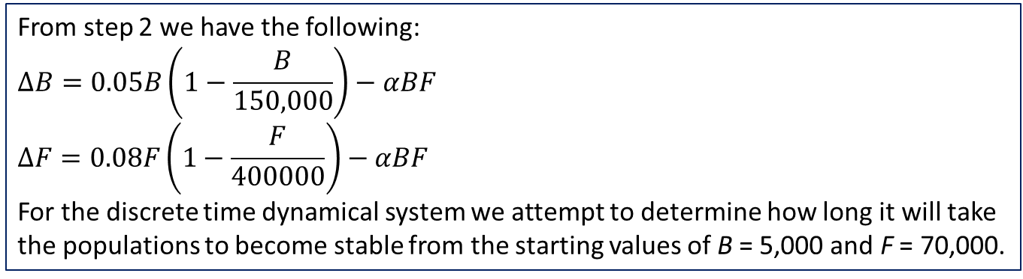
Step 3: Formulate the model
From step 2 we have the following:
$$ΔB=0.05B\left(1−\frac{B}{150,000}\right)−αBF \\ ΔF=0.08F\left(1−\frac{F}{400000}\right)−αBF$$ For the discrete time dynamical system we attempt to determine how long it will take the populations to become stable from the starting values of B = 5,000 and F = 70,000.
Let $x_{1}=B$ and $x_{2}=F$ denote our two state variables, defined on the state space
$\{\left(x_{1},x_{2}\right) :x_{1}≥0, x_{2}≥0\}$.
The system of difference equations are equations are
$$Δx_{1}=f_{1}\left(x_{1},x_{2}\right)=0.05x_{1}\left(1−\frac{x_{1}}{150,000}\right)−αx_{1}x_{2}$$
$$Δx_{2}=f_{2}\left(x_{1},x_{2}\right)=0.08x_{2}\left(1−\frac{x_{2}}{400000}\right)−αx_{1}x_{2}$$
with $x_{1}\left(0\right)=5000$ and $x_{2}\left(0\right)=70000$.
We seek to determine how long it takes the model to reach stability.

Slide 7
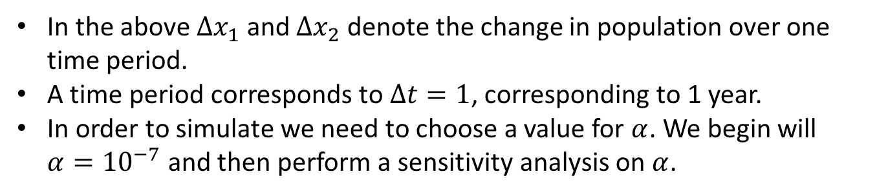
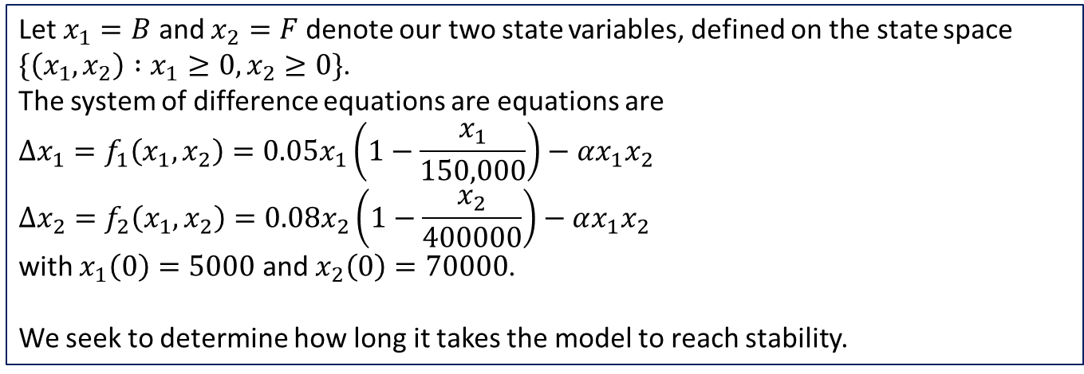
Step 3: Formulate the model
Let $x_{1}=B$ and $x_{2}=F$ denote our two state variables, defined on the state space
$\{\left(x_{1},x_{2}\right) :x_{1}≥0, x_{2}≥0\}$.
The system of difference equations are equations are
$$Δx_{1}=f_{1}\left(x_{1},x_{2}\right)=0.05x_{1}\left(1−\frac{x_{1}}{150,000}\right)−αx_{1}x_{2}$$
$$Δx_{2}=f_{2}\left(x_{1},x_{2}\right)=0.08x_{2}\left(1−\frac{x_{2}}{400000}\right)−αx_{1}x_{2}$$
with $x_{1}\left(0\right)=5000$ and $x_{2}\left(0\right)=70000$.
We seek to determine how long it takes the model to reach stability.
In the above $Δx_{1}$ and $Δx_{2}$ denote the change in population over one time period.
A time period corresponds to $Δt=1$, corresponding to 1 year.
In order to simulate we need to choose a value for $α$. We begin will $α={10}^{−7}$ and then perform a sensitivity analysis on $α$.

Slide 8
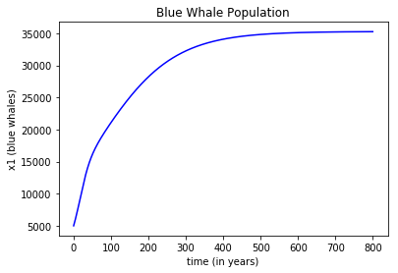
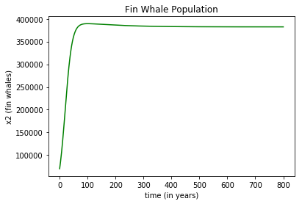
Step 4: Solve the Problem
We simulate the system over 800 years and record the yearly population along with the year each population reaches within 100 of the equilibrium.
Results: (section6-2.py)
It takes approximately 658 years for the blue whale population to near equilibrium.
It takes approximately 66 years for the fin whale population to near equilibrium.

Slide 9
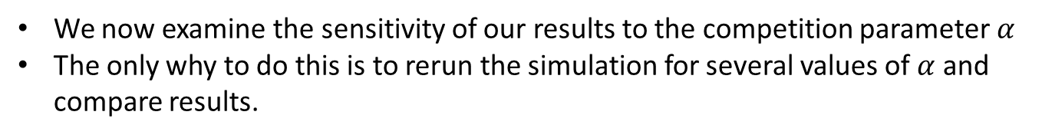
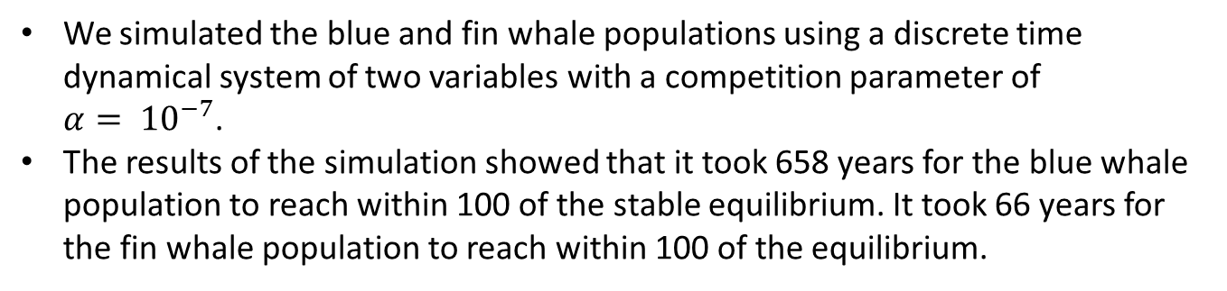
Step 5: Answer the question
We simulated the blue and fin whale populations using a discrete time dynamical system of two variables with a competition parameter of $α= {10}^{−7}$.
The results of the simulation showed that it took 658 years for the blue whale population to reach within 100 of the stable equilibrium. It took 66 years for the fin whale population to reach within 100 of the equilibrium.
It takes a long time for the whale populations to grow back: about 75 years for the fin whales, and several centuries for the more severely depleted blue whales.
We now examine the sensitivity of our results to the competition parameter $α$
The only why to do this is to rerun the simulation for several values of $α$ and compare results.

Slide 10
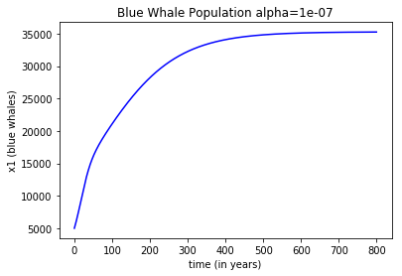
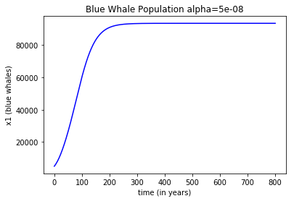


Sensitivity Analysis $α$
We now look at a sensitivity analysis on our competition parameter $α$. To do this we have to rerun the simulation for other values of $α$.

Slide 11
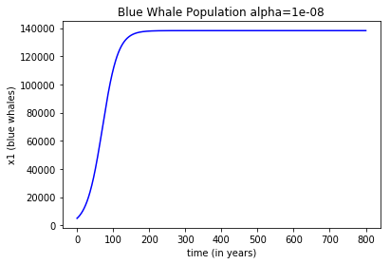


Sensitivity Analysis $α$ (Blue Whales)
The blue whale population has a larger equilibrium and gets there much quicker, although it is still over a century.
Notes:
Start to level off at the carrying capacity after 200 years

Slide 12
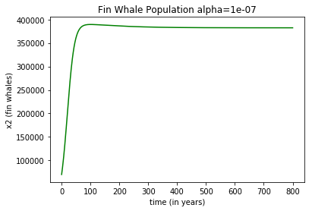
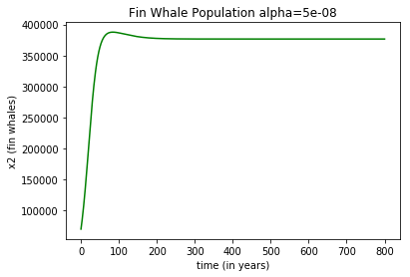

Sensitivity Analysis $α$ (Fin Whales)
Now we examine the fin whales.

Slide 13
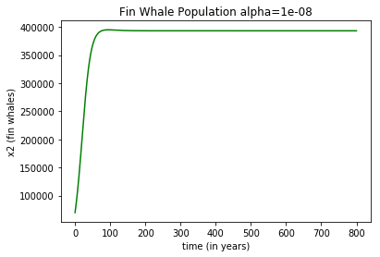
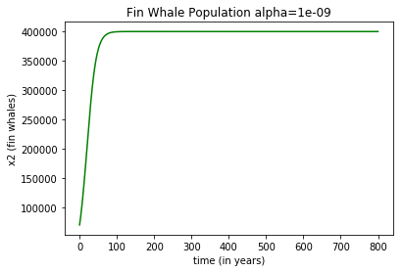
Sensitivity Analysis $α$ (Fin Whales)
There is not much change in the fin whale population in terms of overall size or the time it takes to reach equilibrium.

Slide 14
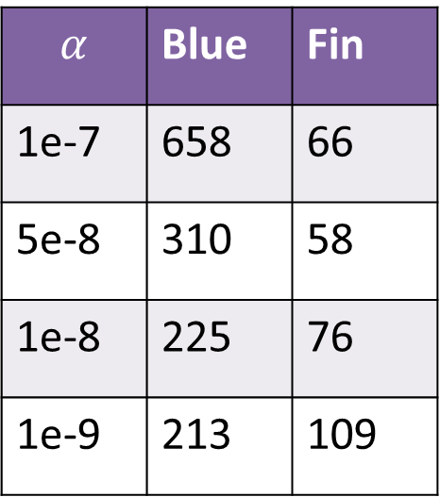
Sensitivity Conclusion
The fin whale population is not very sensitive to the competition parameter. We can expect their population to reach stability within less than a century.
The blue whale population is much more sensitive to the competition parameter. As the parameter decreases, we the time it takes for the blue whales to reach stability reduces drastically at first, but then settles in at a little over 200 years.
At best we looking at a couple centuries for the whale populations to reach stability.
$$α$$ | Blue | Fin
1e-7 | 658 | 66
5e-8 | 310 | 58
1e-8 | 225 | 76
1e-9 | 213 | 109

